Slide 1

Urban Acoustics
Week 3 Tutorial
Conceptual questions
Numerical questions dr.ir. Maarten Hornikx dr. Matthias Cosnefroy

Slide 2
Conceptual questions
1a) :
Road traffic is the most dominant and most annoying source of environmental noise;
7S0X0
2017/02/09
PAGE 1
PAGE <number>

Slide 3
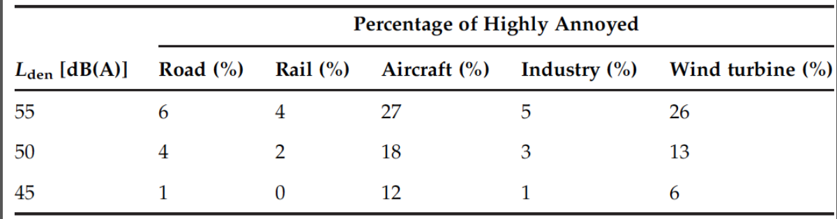
Conceptual questions
1a) :
Road traffic is the most dominant and most annoying source of environmental noise;
Answer
Wrong. Aircraft noise is the most annoying source of environmental noise. Refer Table 6.1, Page 157, Environmental noise pollution
7S0X0
2017/02/09
PAGE 1
PAGE <number>

Slide 4
Conceptual questions
1b) :
The 1000 Hz frequency peak in the spectrum of road traffic noise is caused by tyre-road noise;
2017/02/09
PAGE 2
7S0X0
PAGE <number>

Slide 5
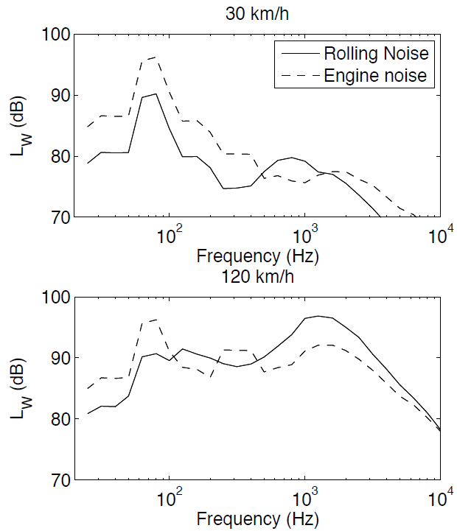
Conceptual questions
1b) :
The 1000 Hz frequency peak in the spectrum of road traffic noise is caused by tyre-road noise;
Answer
Right.
2017/02/09
PAGE 2
7S0X0
PAGE <number>

Slide 6
Conceptual questions
1c) :
Aerodynamic noise around the body of road vehicles is the second most dominant source of noise of road vehicles
2017/02/09
PAGE 3
7S0X0
PAGE <number>

Slide 7
Conceptual questions
1c) :
Aerodynamic noise around the body of road vehicles is the second most dominant source of noise of road vehicles
Answer
Wrong. Rolling noise and Engine noise are the two dominant sources of noise in road vehicles.
2017/02/09
PAGE 3
7S0X0
PAGE <number>

Slide 8
Conceptual questions
1d) :
The noise from aerodynamic sources of trains rapidly increases with the train speed
2017/02/09
PAGE 4
7S0X0
PAGE <number>

Slide 9
Conceptual questions
1d) :
The noise from aerodynamic sources of trains rapidly increases with the train speed
Answer
Right. Refer chapter 5.2.3 Environmental noise pollution.
2017/02/09
PAGE 4
7S0X0
PAGE <number>

Slide 10
Conceptual questions
1e) :
Noise maps produced according to the END should include aircraft noise
2017/03/09
PAGE 5
7S0X0
2017/02/09
PAGE <number>

Slide 11
Conceptual questions
1e) :
Noise maps produced according to the END should include aircraft noise
Answer
Right. Refer chapter 5, Environmental noise pollution.
2017/03/09
PAGE 5
7S0X0
2017/02/09
PAGE <number>

Slide 12
Conceptual questions
1f) :
Aircraft noise is regarded as the most annoying source of transportation noise sources
2017/02/09
PAGE 6
7S0X0
PAGE <number>

Slide 13
Conceptual questions
1f) :
Aircraft noise is regarded as the most annoying source of transportation noise sources
Answer
Right. Refer chapter 5.3, Environmental noise pollution
2017/02/09
PAGE 6
7S0X0
PAGE <number>

Slide 14
Conceptual questions
1g) :
Noise maps have been developed for wind farms in the context of the END
2017/02/09
PAGE 7
7S0X0
PAGE <number>

Slide 15
Conceptual questions
1g) :
Noise maps have been developed for wind farms in the context of the END
Answer:
Wrong, since wind farms are relatively new. Refer to Chapter 6.5, Environmental Noise Pollution. Specific noise maps are being developed for wind farms (which e.g. better account for wind & temperature effects on sound propagation).
2017/02/09
PAGE 7
7S0X0
PAGE <number>

Slide 16
Conceptual questions
1h) :
The problem with wind turbines is its low frequency components
2017/02/09
PAGE 8
7S0X0
PAGE <number>

Slide 17
Conceptual questions
1h) :
The problem with wind turbines is its low frequency components
Answer:
Right. People complain about low-frequency noise from wind farms, although the scientific explanation is not clear yet.
2017/02/09
PAGE 8
7S0X0
PAGE <number>

Slide 18
Conceptual questions
1i) :
At a long distance from a line source of finite length, the sound pressure level from the line source decays with 6 dB with doubling the distance to the line source
2017/02/09
PAGE 9
7S0X0
PAGE <number>

Slide 19
Conceptual questions
1i) :
At a long distance from a line source of finite length, the sound pressure level from the line source decays with 6 dB with doubling the distance to the line source
Answer:
Right. If the line source is finite and the distance between the source and receiver is long, then the line source could be treated as a point source.
2017/02/09
PAGE 9
7S0X0
PAGE <number>

Slide 20
Conceptual questions
1j) :
The sound power from a point source reduces with distance from the source.
2017/02/09
PAGE 10
7S0X0
PAGE <number>

Slide 21
Conceptual questions
1j) :
The sound power from a point source reduces with distance from the source.
Answer:
Wrong. Sound power is not a property of the distance between the source and receiver. It describes the source in isolation, independently of propagation effects.
2017/02/09
PAGE 10
7S0X0
PAGE <number>

Slide 22
Exercises
2):
Plans are made to build a residential area close to a highway. To analyse the noise level due to the highway in this area, you need to compute the noise level at a position 50 m and a position 100 m away from the highway.
Assume that the highway is very long and straight. The averaged sound power level from this highway has been estimated at E = 91.5 dB(A). Compute the sound pressure level in dB(A) at the two receiver points. Neglect the effect of the ground.
50 meters
100 meters
PAGE 11
7S0X0
2017/02/09
PAGE <number>

Slide 23
Exercises
Answer 2a):
Long and straight road → line source
Replace:
Here, the sound power is in dB(A), so the sound level is also in dB(A)
(i.e., don’t apply the correction twice)
2017/02/09
PAGE 12
7S0X0
PAGE <number>

Slide 24
Exercises
2)b)
50 m at the other side of the road, a small industrial building is located. The building produces a high noise level and the sound power is estimated at E = 111.1 dB(A).
Compute the total noise level at the two receiver positions from the highway and the industrial building, while considering the building as a point source. Explain the sound level difference between the two receiver position compared to the answer of 2a).
2017/02/09
PAGE 13
7S0X0
PAGE <number>

Slide 25
Exercises
50 meters
50 meters
100 meters
2017/02/09
7S0X0
PAGE 14

Slide 26
Exercises
Answer 2b):
Noise from the industrial building (point source):
Total noise from both sources (logarithmic summation):
The industrial building only adds about 1 dB(A) for both receivers to the total sound level, since the building is far away. Since its noise decreases faster with range compared to the road (because it’s a point source), the noise from the road will be more dominant at long range.
2017/02/09
PAGE 15
7S0X0
PAGE <number>

Slide 27
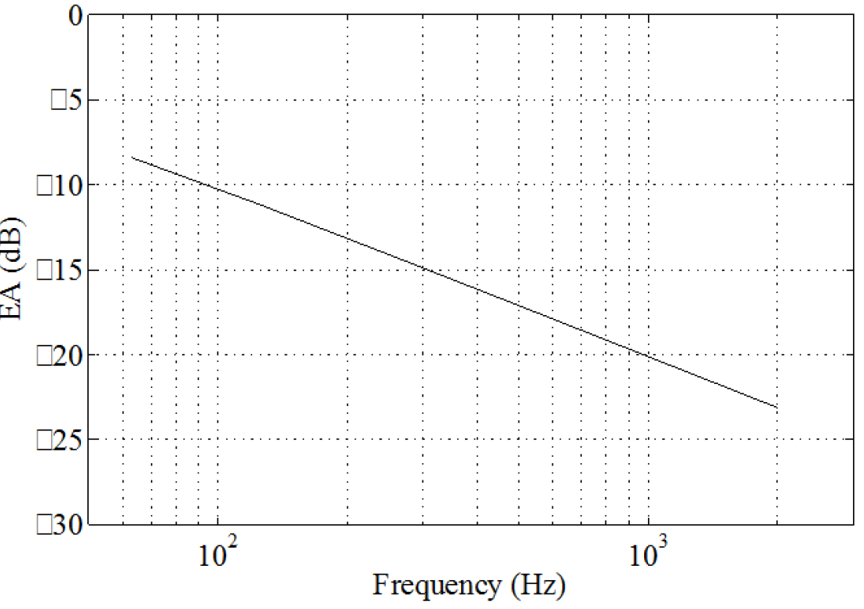
Exercises
2c): To reduce the noise in the area, you have found information on the reduction of noise by a noise screen, see Figure below. To assess the potential reduction of noise by the screen for road traffic and the industrial noise source, you also have access to the power spectra of the road traffic and the industrial building, see Table below.
-
Spectral effect of a noise screen expressed by EA (Excess Attenuation) in dB: a negative EA value means a reduction of noise
-
-
-
-
-
2017/02/09
PAGE 16
7S0X0
PAGE <number>

Slide 28
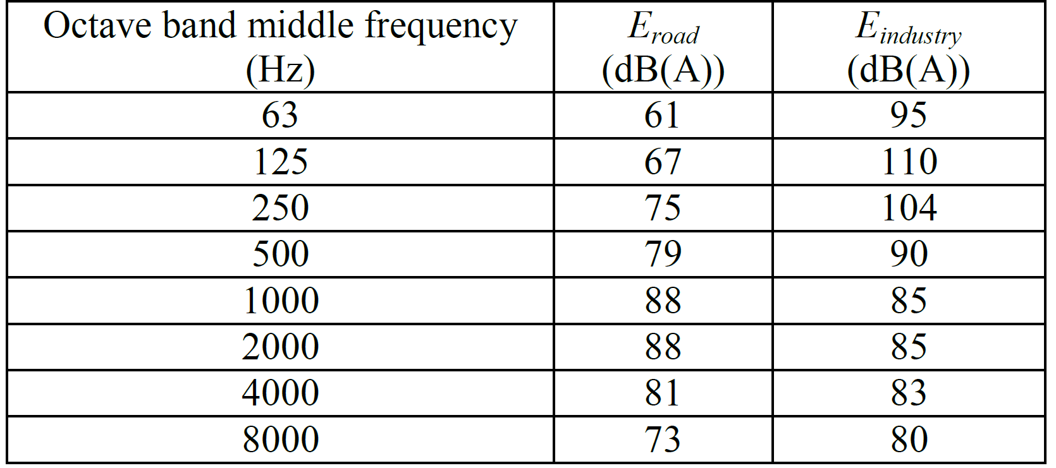
Exercises
Answer 2c):
The sound power of the road is loudest at the high frequencies
The sound power of the building is loudest at the low frequencies
The screen reduces noise better for the higher frequencies
The noise from the road is louder at the receiver positions, compared to the building
→ The screen will be more effective to reduce noise from the road
Spectral values of the sound power from the road and industry building.
2017/02/09
PAGE 21
7S0X0
PAGE <number>

Slide 29
Exercises
3):
Two different wind turbines are located 300m from each other. You need to calculate the distance dependent sound level in the direction of a residential area. The second wind turbine is always 300 m further away than the first turbine in this direction. You plan to measure the sound pressure level at some points and extract the sound power level from the two turbines using this data. Once you have the sound power levels, you can compute the sound pressure level at all possible distances from the turbines. How many measurements are needed in this strategy. Consider the wind turbines as point sources and neglect the ground effect for simplicity.
2017/02/09
PAGE 22
7S0X0
PAGE <number>

Slide 30
Exercises
Answer 3):
This is a tricky question. The sound level generated by each individual turbine (T1 and T2, considered as point sources) at position r is given as
The total sound level can be computed with:
By measuring at 2 locations r₁ and r₂ , you would measure
From this, by replacing the above expressions, you could in theory estimate the sound power E_{T1} and E_{T2} of the 2 turbines as the solution of a system of 2 equations and 2 unknowns.
This is however not so easy to do analytically...
2017/02/09
PAGE 23
7S0X0
PAGE <number>

Slide 31
Questions?
m.h.r.cosnefroy@tue.nl
7S0X0 / 7W8X0
2017/02/09
PAGE 24
PAGE <number>

